Slide 1

Mocha - Istanbul-
Git - CircleCI
By Josias Moukpe

Slide 2
What are Mocha, Istanbul, Git, CircleCI?
Mocha
Mocha is a JavaScript test framework for Node.js programs, featuring browser support, asynchronous testing, test coverage reports, and use of any assertion library
Istanbul (nyc)
Istanbul instruments your JavaScript code with line counters, so that you can track how well your unit-tests exercise your codebase.
Git (github)
Git is a distributed version-control system for tracking changes in source code during software development. Its goals include speed, data integrity, and support for distributed, non-linear workflows.
CircleCi (2.0)
CircleCI allows teams to rapidly build quality projects, at scale. Our mission is to give people everywhere the power to build and deliver software at the speed of imagination.

Slide 3
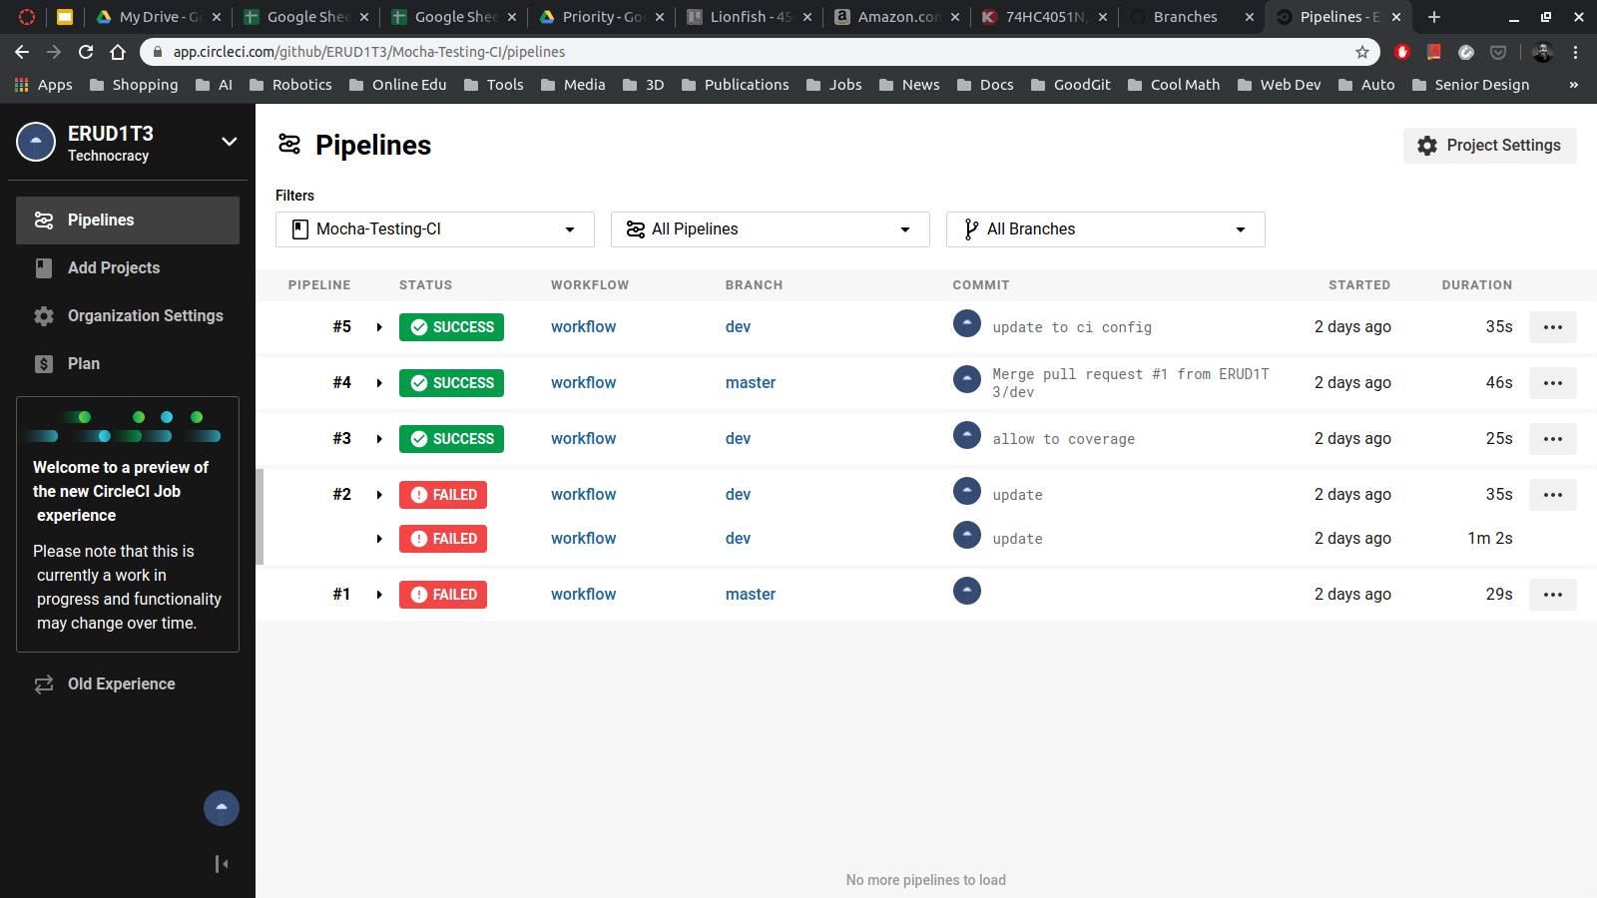

Slide 4
After several NPM calls later ...

Slide 5
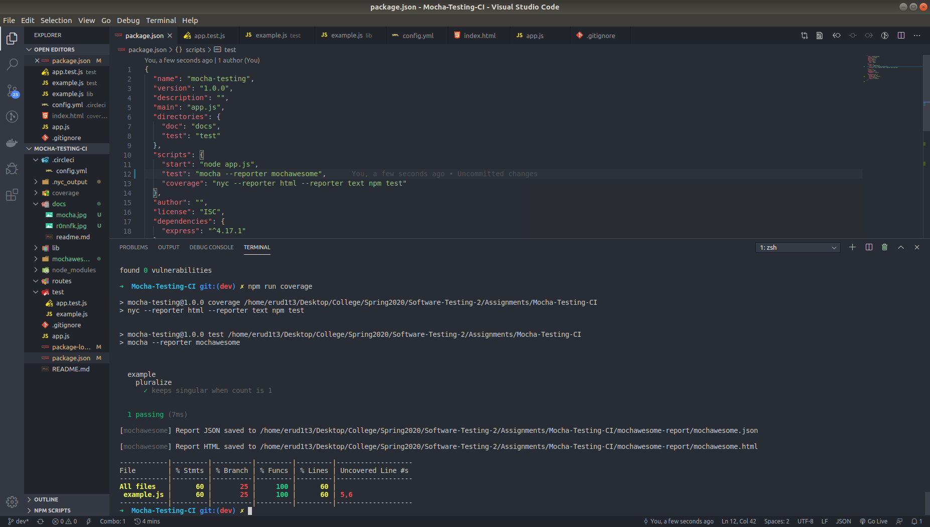

Slide 6
Workflow
Create a test/ directory in the root directory of your project. It will contain all the source code to test your app’s source codes
Setup couple of tests
Add testing scripts to your package.json file for testing and code coverage
Run test locally (Should pass!)
Commit and Push your changes to origin/master
Create a dev branch and protect your master branch using branch protection setup to passing CircleCI test
Create a Git repo for the app you are building with .gitignore setup to NodeJs
Create a free CircleCI account and add your repo to the testing pipeline
Clone your repo locally and add source codes for your app (npm init, npm install, all routes and js functions)
Add .circleci/config.yml file to setup the parameters of the test
Install mocha and nyc (Istanbul) as dev dependencies

Slide 7
Live Demo (before)

Slide 8
Quick sacrifice to appease the demo gods

Slide 9
Live Demo

Slide 10
Assignment
Create “Hello World” Webapp using NodeJS
Make a function called Hello that display a greeting on Webapp’s main page
Write test for the function’s output
Run the test locally and see the result (test should pass)
Change the output of the Hello function and re-run the test (test should fail)

